Slide 1
職場故事
(Animaze)

Slide 2

Notes:
https://pixabay.com/videos/warrior-logo-gamer-play-152073/

Slide 3
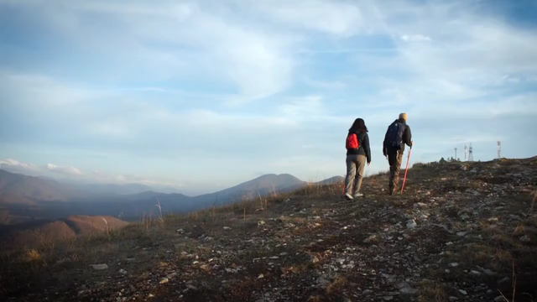
1.目標
Notes:
https://pixabay.com/videos/ascent-mountains-tourists-walk-30221/

Slide 4
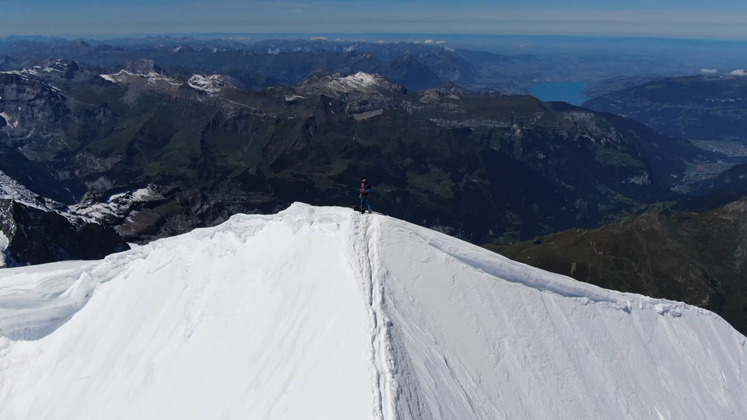
Notes:
https://pixabay.com/videos/mountains-forest-sunset-climb-128225/

Slide 5
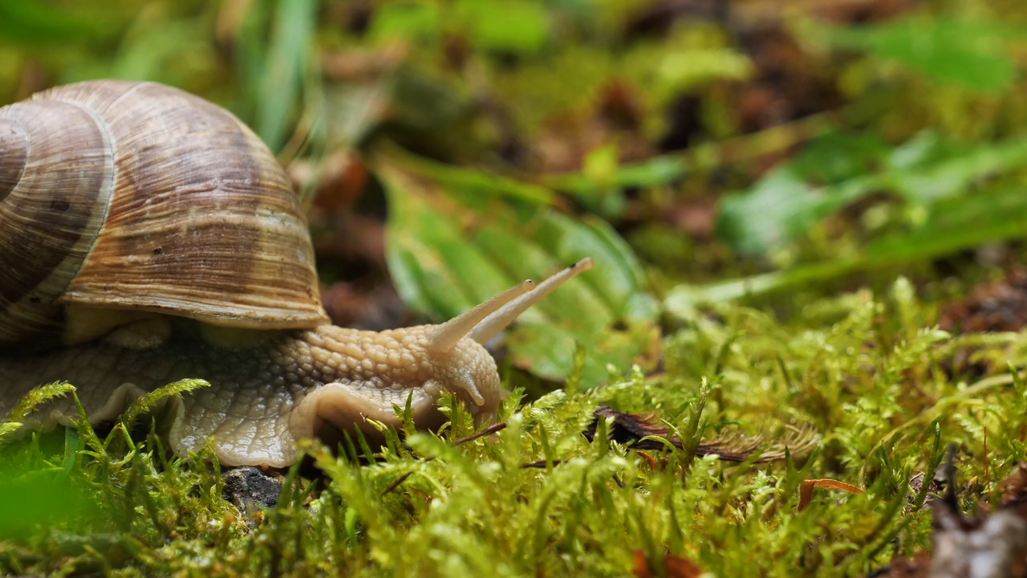
2.阻礙
Notes:
https://pixabay.com/videos/snail-mollusk-creeping-animal-169471/

Slide 6

2.阻礙
Notes:
https://pixabay.com/videos/stairs-upstairs-wolf-greenscreen-83070/

Slide 7

Notes:
https://pixabay.com/videos/push-challenge-angry-fight-108415/

Slide 8
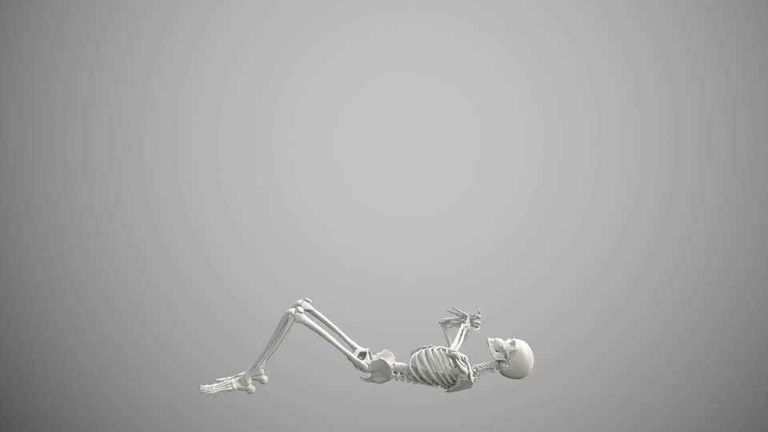
3.努力
Notes:
https://pixabay.com/videos/sit-ups-fit-sports-training-bones-84706/

Slide 9

Notes:
https://pixabay.com/videos/computer-science-face-digital-robot-204261/

Slide 10
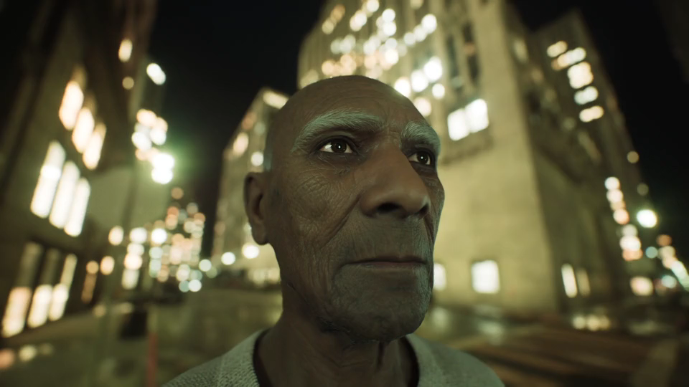
4.結果
Notes:
https://pixabay.com/videos/man-old-man-old-asian-man-big-city-135320/

Slide 11
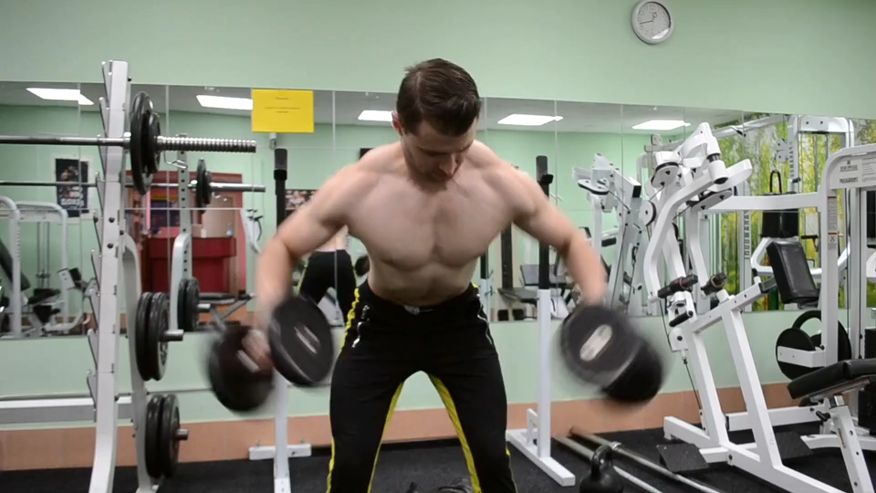
Notes:
https://pixabay.com/videos/bodybuilding-sports-crossfit-39376/

Slide 12
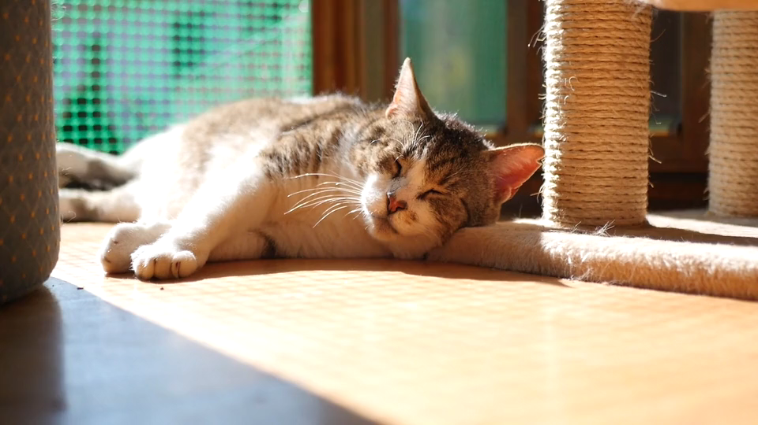
Notes:
https://pixabay.com/videos/cat-sleep-cute-animal-pet-home-22835/

Slide 13
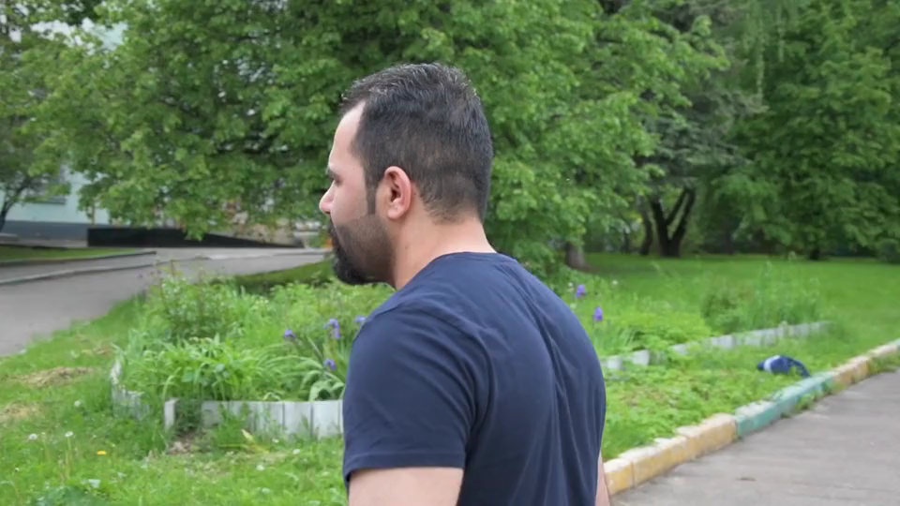
Notes:
https://pixabay.com/videos/racism-conflict-people-argument-42854/

Slide 14
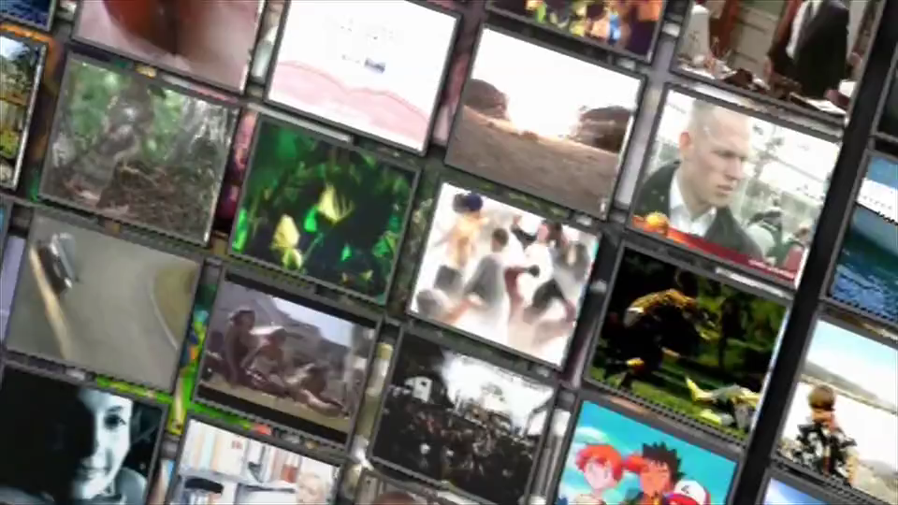
5.意外
Notes:
https://pixabay.com/videos/video-wall-tv-channels-wall-media-5366/

Slide 15
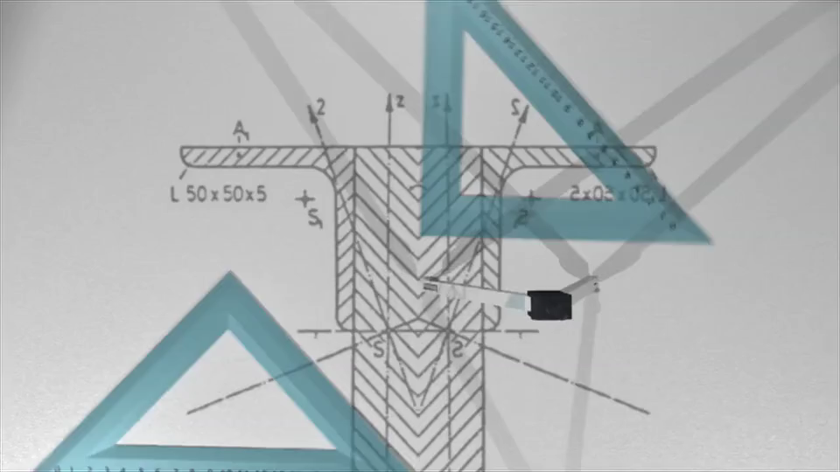
Notes:
https://pixabay.com/videos/science-school-math-lab-learn-5373/

Slide 16
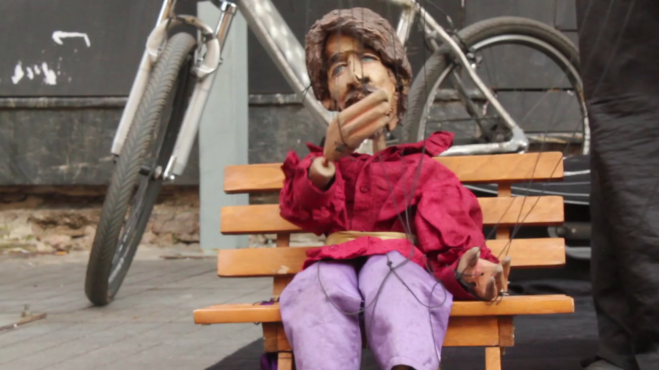
6.轉彎
Notes:
https://pixabay.com/videos/puppet-show-street-life-puppet-1697/

Slide 17
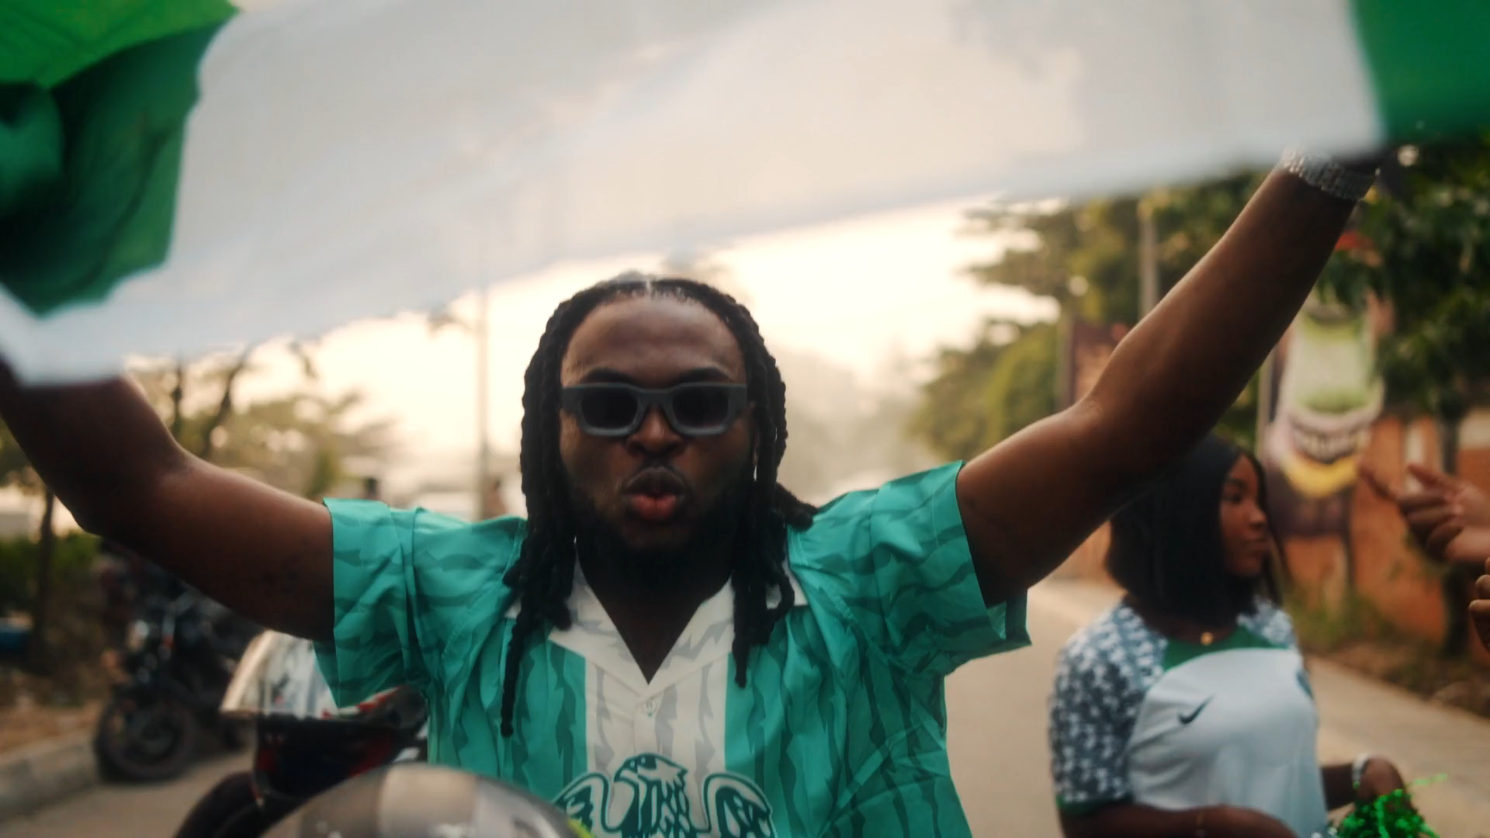
Notes:
https://pixabay.com/videos/celebration-dancing-excitement-201013/

Slide 18

7.結局
Notes:
https://pixabay.com/videos/green-lightbulb-idea-3d-cartoon-115983/

Slide 19
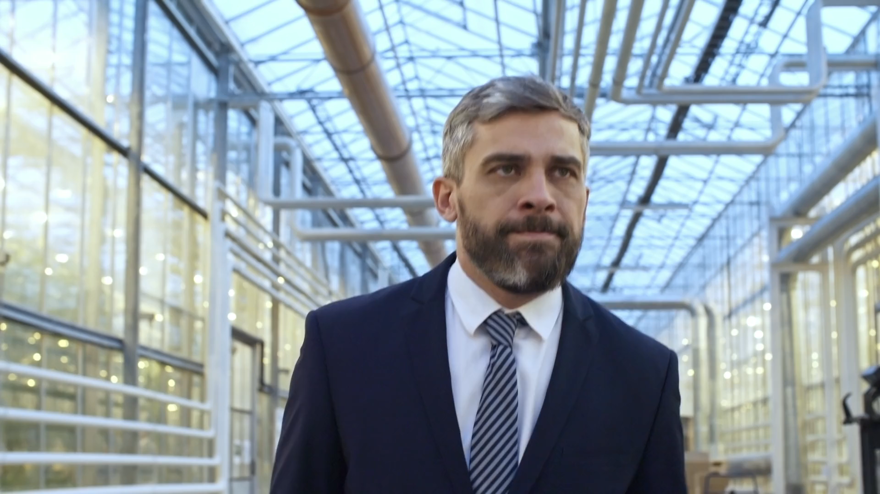
Notes:
https://pixabay.com/videos/man-walking-suit-business-office-199623/

